Slide 1

LGE Internal Use Only
Test Technique Guide
VS SW Process Unit
LG Electronics

Slide 2
Revision History
Version | Date | Comment | Author | Approver
1.0 | 2016.08.22 | Initial Release | EPG | VC Dev. Engineering FD
1.1 | 2019.02.04 | Update due to annual organization restructuring (VC --> VS) | VS SW Process Unit leader | VS SW Process Unit leader

Slide 3
Contents
Test Overview
Test Technique Definition
Test Technique : Analysis of Requirements
Test Technique : Equivalence Partitioning
Test Technique : Boundary Value Coverage
Test Technique : Error guessing

Slide 4
1. Test Overview
[Definition of Test]
A series of processes that examine and evaluate whether a system meets specified requirements and whether there is a difference between expected and actual results
A set of actions and procedures that operate a program to find unexposed defects
[performance of the test]
- After performing the input defined in the test case, compare the output result with the expected result
Test Case
Test Result
1. perform defined input
input
Retest after modification
2. record the output
actual
Output result = expected result : passed
Output result ≠ expected result : failure
3. Compare with expected results
Fail
expected
Pass/Fail
Pass

Slide 5
1. Test Overview : Test Case
A test case for performing a test consists of 1) an input value and 2) an expected value..
Q) Is the expected value necessary? Shouldn't it be judged when performing a test?
A) It is known that if the expected value is not defined in advance and judged during the test, there is a psychological tendency to judge the result positively.
That is, it recognizes that the wrong answer is momentarily correct. In order to suppress this tendency, an expected value is required in advance.
Test Case
Test Result
1. perform defined input
input
If the expected value is not defined, there is a tendency to make mistakes in judging the test result, so the expected value should be defined in advance.
2. record the output
actual
3. Compare with expected results
Fail
expected
Pass/Fail
Pass

Slide 6
2. Test Technique Definition
A test technique is often referred to as a 'Test Criteria' as it provides criteria for selecting test cases..
In this guide, testing techniques are categorized as follows:
Analysis of Requirements
Equivalence Partitioning
Boundary Value Coverage
Error guessing

Slide 7
3. Test Technique : Analysis of Requirements
Analyze the requirements content to extract test inputs.
The input field is set to the value specified in the requirement or reference document for the requirement.
The input output for writing the test case is as follows..
Customer requirements, system requirements, HSI, SysAD, SW requirements, SAD, LLD, etc.
Testing through the requirements analysis technique is the most basic test.

Slide 8
4. Test Technique : Equivalence Partitioning (1/2)
It targets the interface of the test target and extracts test inputs based on relationships between inputs and functions.
The input area is divided into intervals that can be considered ‘equal’..
The test inputs within the partitioned interval are considered equal no matter what value is chosen.
For example, if a function is different depending on whether or not a minor is
Whether they are 15 or 16, they are considered “the same” in that they are all minors.
Likewise, 30 or 40 years old are considered 'same' in the sense that they are not minors.
Therefore, for this function, the ‘age input area’ can be divided into a ‘minor section’ and an ‘adult section’.
Similarly, equivalence partitioning can be applied based on the relationship between output and function..
for example,If the requirement describes the operability within the operating range value, use the Equivalence Partitioning technique.If the requirement is out of the operating range value, the Boundary Value Coverage technique is used when it is expected that a large system failure will occur.

Slide 9
4. Test Technique : Equivalence Partitioning (2/2)
The following example performs an input domain equivalence partition.
Consider the following functional specification for shock detection in a black box system.
functional specification
Impact information is output in 4 stages according to the following
acceleration sensor values.
1 - 5 : Step 1
6 - 10 : Step 2
11 - 15 : Step 3
16 or higher: 4th level
Equivalent division
Split the input area
[1..5] : Step 1
[6..10] : Step 2
[11..15] : Step 3
[16..255] : Step 4
Basically follows the division of the functional specification
It is necessary to consider the maximum value of the input area not specified in the functional specification.
Need to consider practical constraints not specified in the functional specification

Slide 10
5. Test Technique : Boundary Value Coverage (1/3)
It is applied to each input section divided through equivalence division, etc.
Select the following test input data for each input section [N..M].
Priority 1 (effective value): Minimum (N), Maximum (M)
Priority 2 (invalid value): one below the minimum (N-1), one above the maximum (M+1)
Priority 3 (effective value): One above the minimum (N+1), one below the maximum (M-1)
Design test cases based on prioritization of test input efforts..
This is useful for programs with many conditional statements.
In these programs, many mistakes are made at the boundary, such as the confusion of '>' and '>='.

Slide 11
5. Test Technique : Boundary Value Coverage (2/3)
The following example selects a boundary value as a test input.
functional specification
Impact information is output in 4 stages according to the following acceleration sensor values.
1 - 5 : Step 1
6 - 10 : Step 2
11 - 15 : Step 3
16 or higher: 4th level
Equivalent division
Select a boundary value in each input interval.
Since there are 4 input intervals, you need to select at least 4 input data: All divisions must be ‘covered’
Depending on the test cost, additionally select a test input centered on the boundary value
Split the input area
[1..5] : Step 1
[6..10] : Step 2
[11..15] : Step 3
[16..255] : Step 4
Boundary Value
test input data
- [1..5] : 1
- [6..10] : 10
- [11..15] : 11
- [16..255] : 255

Slide 12
5. Test Technique : Boundary Value Coverage (3/3)
The following example selects a boundary value as a test input.
functional specification
When Power supply is between 6V and 16V, Controller shall work normally.
Equivalent division
Split the input area
- [0..5] : abnormal mode
- [6..16] : normal mode
- [17..20] : abnormal mode
Boundary Value
test input data
- [0..5] : 5
- [6..16] : 6, 16
- [17..20] : 20

Slide 13
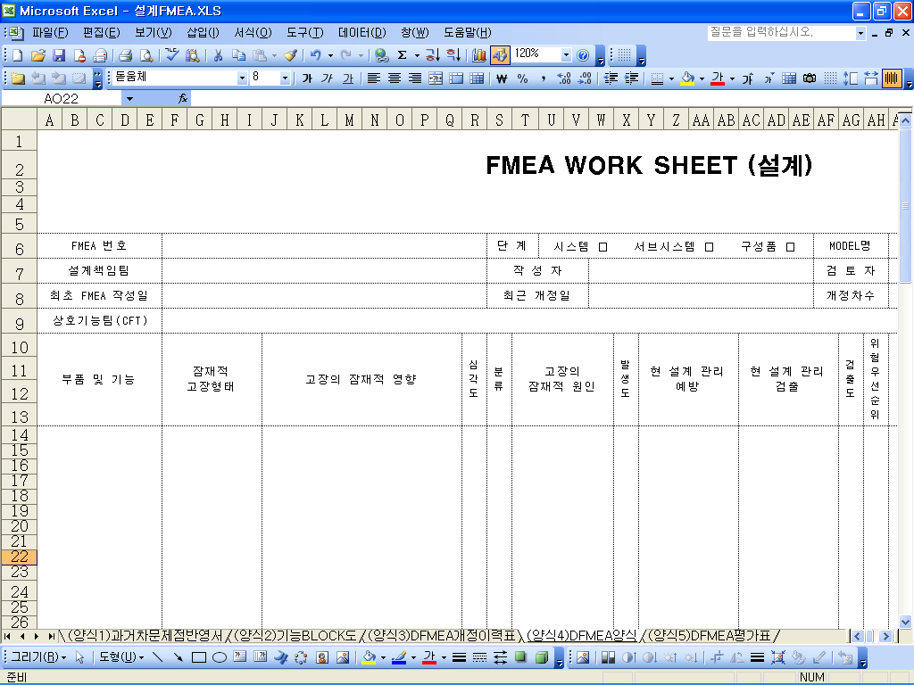
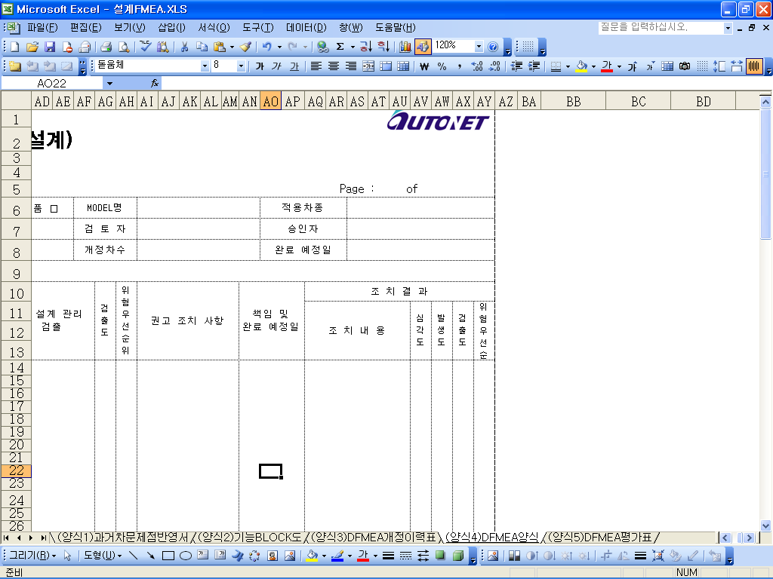
6. Test Technique : Error guessing
Design test cases using test experience and knowledge and intuition about the test subject.
Test cases can be designed using problems that have occurred in the past or FMEA results.

Slide 14
End of Document

